Slide 1

GTHA housing market database
Teranet Exploratory Data Analysis
Future steps
Teranet meeting
16-Aug-2019
Presented by: Stepan Oskin
Photo by Maarten van den Heuvel

Slide 2
Presentation content
1. Overview of the current state of the project
2. Data flow
3. PostgreSQL
4. Future steps
5. EDA results

Slide 3
Section 1:
Overview of the current stage of the project

Slide 4
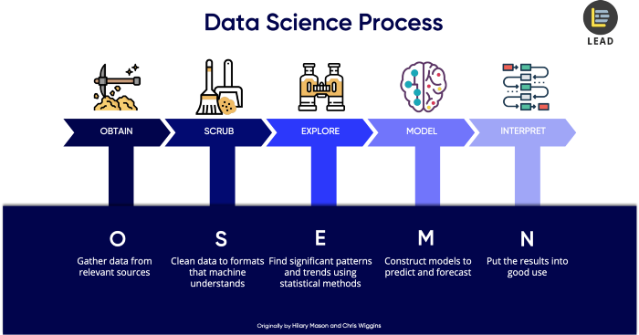
1.1 OSEMN methodology
Originally by Hillary Mason and Chris Wiggins
Source: Dr. Cher Han Lau, LEAD (https://thelead.io)

Slide 5
1.2 MASc thesis scope
Focus of this master thesis
Future work

Slide 6
1.2 Steps completed
1. Obtain:
Collect data from various sources
Assemble GTHA housing database
2. Scrub:
Clean Teranet dataset
Add necessary attributes
3. Explore:
Explore Teranet dataset
Determine data quality issues

Slide 7

Section 2:
Data flow
This Photo by Unknown Author is licensed under CC BY-SA

Slide 8
2.1 Data flow: Teranet dataset stages
During Step 2: Scrub of the OSEMN methodology,
the Teranet dataset is transformed in 5 main stages:
Remove duplicates
(pending)
Raw
Teranet
data
2.
3.
final
0.
Add foreign
keys via spatial joins
1.
Correct
for
consistency
Add new attributes
Add to the database
HHSaleHistory.csv
2_Teranet_consistent.csv
PostgreSQL
Folder:
data/teranet/
1.1_Teranet_DA_cols.csv
3_Teranet_new_cols.csv
1.2_Teranet_DA_TAZ_cols.csv
3_Teranet_nonan_new_cols.csv

Slide 9
2.1 Data flow: Teranet dataset transformations
Transformation is performed in Python in 4 main steps:
2.1.1_teranet_gtha_da_spatial_join.ipynb
2.3_teranet_new_cols.ipynb
2.1.2_teranet_taz_spatial_join.ipynb
2.3_teranet_nonan_new_cols.ipynb
Folder:
notebooks/2.scrub/
2.2_teranet_consistency.ipynb
Remove duplicates
(pending)
Raw
Teranet
data
2.
3.
final
0.
Add foreign
keys via spatial joins
1.
Correct
for
consistency
Add new attributes
Add to the database
1.
2.
3.
HHSaleHistory.csv
2_Teranet_consistent.csv
PostgreSQL
Folder:
data/teranet/
1.1_Teranet_DA_cols.csv
3_Teranet_new_cols.csv
1.2_Teranet_DA_TAZ_cols.csv
3_Teranet_nonan_new_cols.csv

Slide 10

Section 3:
PostgreSQL database
This Photo by Unknown Author is licensed under CC BY

Slide 11

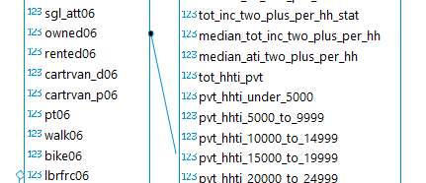
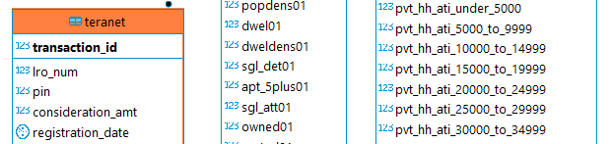
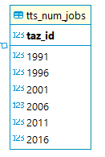



Entity relationship (ER) diagram

Slide 12
Teranet table can be linked to many datasets via added foreign keys:
Profiles of income
Teranet
Number of jobs
Land use information

